Slide 1
Prime Numbers
A prime number is a whole number greater than 1, which is only divisible by 1 and itself.
First few prime numbers are : 2, 3, 5, 7, 11, 13, 17, 19, 23 …..
Primality Test
Algorithm for determining whether an input number is prime

Slide 2
Some interesting fact about Prime numbers
2 is the only even Prime number.
Every prime number can represented in form of 6n+1 or 6n-1, where n is natural number.
2, 3 are only two consecutive natural numbers which are prime too.

Slide 3
Some interesting fact about Prime numbers
If n is a prime number, then for every a, 1 <= a < n,
a^{n-1} ≡ 1 (mod n)
OR
a^{n-1} % n = 1 (Fermat’s Little Theorem)

Slide 4
How do we check whether a number is Prime or not?
Naive solution
Iterate through all numbers from 2 to n-1 and for every number check if it divides n
static boolean isPrime(int n)
{
if (n <= 1)
return false;
for (int i = 2; i < n; i++)
if (n % i == 0)
return false;
return true;
}

Slide 5
How do we check whether a number is Prime or not?
2. Efficient solutions (Divisors are always appear in pairs)
Instead of checking till n, we can check till √n because a larger factor of n must be a multiple of smaller factor that has been already checked
A trial division to test the primality of 100
Divisors of 100: 2, 4, 5, 10, 20, 25, 50
Largest factor is 100/2 = 50
All divisors of n are less than or equal to n/2
Some of divisors are redundant
Once we reach 10, which is √100, the divisors just flip around and repeat

Slide 6
How do we check whether a number is Prime or not?
More optimized solution
Every natural number can be represented as 6k + i for i= 0,1,2,3,4,5
All primes are of the form 6k ± 1, with the exception of 2 and 3. So, check through all the numbers of form 6k ± 1 only.

Slide 7
How do we check whether a number is Prime or not?
static boolean isPrime(int n)
{
// Corner cases
if (n <= 1) return false;
if (n <= 3) return true;
// This is checked so that we can skip
// middle five numbers in below loop
if (n % 2 == 0 || n % 3 == 0) return false;
for (int i = 5; i * i <= n; i = i + 6)
if (n % i == 0 || n % (i + 2) == 0)
return false;
return true;
}

Slide 8
Full Prime Number
class Prime{
// function to check digits
public static boolean checkDigits(int n)
{
// check all digits are prime or not
while (n > 0) {
int dig = n % 10;
// check if digits are prime or not
if (dig != 2 && dig != 3 &&
dig != 5 && dig != 7)
return false;
n /= 10;
}

Slide 9
return true;
}
// To check if n is prime or not
public static boolean prime(int n)
{
if (n == 1)
return false;
// check for all factors
for (int i = 2; i * i <= n; i++) {
if (n % i == 0)
return false;
}
return true;
}

Slide 10
// To check if n is Full Prime
public static boolean isFullPrime(int n)
{
// The order is important here for
// efficiency
return (checkDigits(n) && prime(n));
}
// driver code
public static void main(String[] args)
{
int n = 53;
if (isFullPrime(n))
System.out.print( "Yes" );
else
System.out.print( "No");
}
}

Slide 11
How do we check whether a number is Prime or not?
(2) Fermat’s Little Theorem:
If n is a prime number, then for every a, 1 <= a < n,
a^{n-1} ≡ 1 (mod n)
OR
a^{n-1} % n = 1
e.g. Since 7 is prime,
2⁶ ≡ 1 (mod 7),
3⁶ ≡ 1 (mod 7),
4⁶ ≡ 1 (mod 7)
5⁶ ≡ 1 (mod 7) and
6⁶ ≡ 1 (mod 7)

Slide 12
How do we check whether a number is Prime or not?
(2) Fermat’s Little Theorem:
If n is a prime number, then for every a, 1 <= a < n,
a^{n-1} ≡ 1 (mod n)
OR
a^{n-1} % n = 1
If a given number is prime, then this method always returns true
If given number is composite (or non-prime), then it may return true or false (but the probability of producing incorrect result for composite is low and can be reduced by doing more iterations)

Slide 13
How do we check whether a number is Prime or not?
(2) Fermat’s Little Theorem:
// Higher value of k indicates probability of correct results for composite inputs become higher. For prime inputs, result is always correct
Step 1 Repeat following k times:
a) Pick a randomly in the range [2, n - 2]
b) If a^{n-1} ≢ 1 (mod n), then return false
Step 2 Return true [probably prime].

Slide 14
Fermat Factoring Method
Fermat's Factorization Method is a technique used to factorize a composite number into its prime factors. It is based on the fact that if n is a composite number, then it can be expressed as a product of two factors x and y, where p and q are close to the square root of n.
Foundation: Fermat's Factorization is based on the idea that a composite number n can be written as n=p×q, where p and q are factors of n. If p and q are close to each other, then n can be factored by finding a suitable pair of integers x and y such that: We have predefined notation
n=x²−y²

Slide 15
How do we check whether a number is Prime or not?
(3) Sieve of Eratosthenes:
The sieve of Eratosthenes is one of the most efficient ways to find all primes smaller than n Time complexity : O(nloglogn)

Slide 16
(3) Sieve of Eratosthenes: The sieve of Eratosthenes is one of the most efficient ways to find all primes smaller than n

Slide 17
(3) Sieve of Eratosthenes: The sieve of Eratosthenes is one of the most efficient ways to find all primes smaller than n
Create a list of consecutive integers from 2 to n: (2, 3, 4, …, n)
Start with a smallest prime number i.e. p=2
Mark all multiples of p which are less than n as composite. We will mark the number as 0. (Do not mark p itself as composite)
Assign the value of p to the next non zero number in the list which is greater than p.
Repeat the process until p*p<=n

Slide 18
func(N)
{
prime[N+1] //array of size
for(i=2 to N)
prime[i]=1
For(i=2 to N) {
if(prime[i]==1)
for(j=2*i;j<=N;j+=i)
{
prime[j]=0;
} } }
for(i=2 to N)
{
if(prime[i]==1)
print(i);
}

Slide 19
func(N)
{
prime[N+1] //array of size
for(i=2 to N)
prime[i]=1
For(i=2 to i*i<=N;i++) {
if(prime[i]==1)
for(j=i*i;j<=N;j+=i)
{
prime[j]=0;
} } }
for(i=2 to N)
{
if(prime[i]==1)
print(i);
}

Slide 20
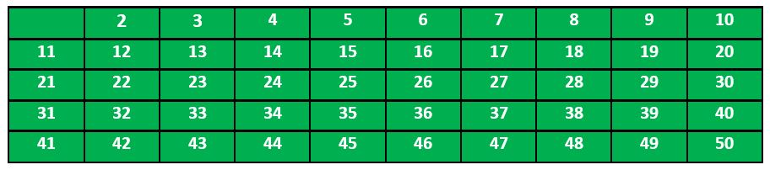
e.g. when n = 50,
Step 1: print all print numbers smaller than or equal to 50.
Step 2: Initialize p = 2
Step 3: Mark all the numbers which are divisible by p

Slide 21
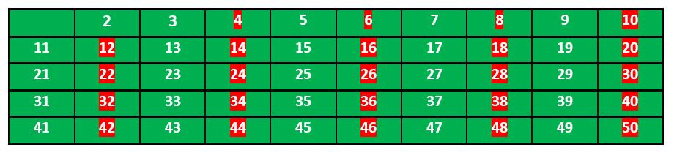
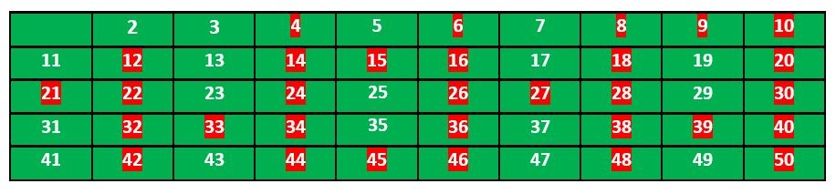
Step 4: Find the first number greater than p in the list that is not marked.
p=3, repeat Step 3

Slide 22
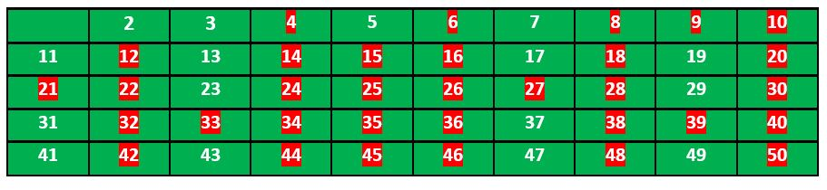
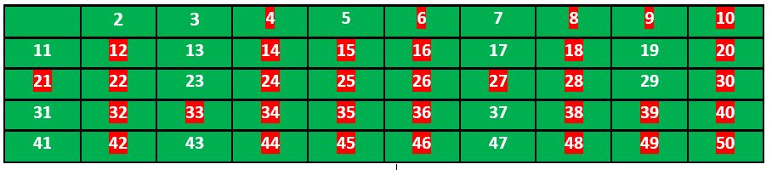
Now, p=5,
Continue this process and our final table will look like as below,

Slide 23
void sieveOfEratosthenes(int n){
boolean prime[] = new boolean[n+1];
for(int i=0;i<n;i++)
prime[i] = true;
for(int p = 2; p*p <=n; p++){
if(prime[p] == true){
for(int i = p*2; i <= n; i += p)
prime[i] = false;
}
}
for(int i = 2; i <= n; i++){
if(prime[i] == true)
System.out.print(i + " ");
}
}

Slide 24
How do we check whether a number is Prime or not?
(3) Sieve of Eratosthenes:
when n is large
An array of size Θ(n) may not fit in memory
The simple Sieve is not cache friendly even for slightly bigger n. The algorithm traverses the array without locality of reference

Slide 25
How do we check whether a number is Prime or not?
(4) Segmented Sieve:
Divide the range [0..n-1] in different segments
Size of each segment is √n
Compute primes in all segments one by one

Slide 26
Segmented Sieve The segmented sieve algorithm is an optimization of the classic Sieve of Eratosthenes, designed to handle large ranges. The idea is to first find all primes up to sqrt(R)​ using the regular sieve and then use these primes to mark non-prime numbers in the range [L,R].
Steps:
Find All Primes up to sqrt{R} by use of Sieve of Eratosthenes
Mark Non-Prime Numbers in [L,R]
a) create Boolean array of size R-L+1 and initialize as true
b) for each prime p in step 1, mark all multiples of p in the range {L,R} as false
3. Output the primes that remain as true.

Slide 27
Sieve of Eratosthenes vs Segmented Sieve Purpose: The Sieve of Eratosthenes is a classical algorithm used to find all prime numbers up to a given number N and it is highly efficient for finding all primes within a small to moderate range. The Segmented Sieve is used to find all prime numbers within a specific range [L,R] and It's efficient for large ranges
Time complexity of Segmented Sieve: O(√ R​loglog √ R ​+(R−L+1)loglog √ R​) and space complexity O(√ R​+(R−L+1))

Slide 28
Step 1- Find all primes up to sqrt(R)
Step 2- Collect all primes up to sqrt(R)
Step 3- create Boolean array
int rangeSize = R - L + 1;
boolean[] isPrimeRange = new boolean[rangeSize];
Step 4- Use the primes to mark non-primes in the range [L,R]
for (int prime : primes)
{
int start = Math.max(prime * prime, (L + prime - 1) / prime * prime);
for (int j = start; j <= R; j += prime)
{
isPrimeRange[j - L] = false;
} }

Slide 29
Find all prime factors of a given number
Every natural number greater than 1 is either a prime itself or can be factorized as a product of primes that is unique up to their order. E.g. 315, can be written as 3 *3 * 5* 7
Writing a number as a product of prime numbers is called a prime factorization of the number. e.g. 3, 3, 5, 7 are prime factors of 315

Slide 30
Find all prime factors of a given number
1) While n is divisible by 2, print 2 and divide n by 2.
2) After step 1, n must be odd. Now start a loop from i = 3 to square root of n. While i divides n, print i and divide n by i, increment i by 2 and continue.
3) If n is a prime number and is greater than 2, then n will not become 1 by above two steps. So print n if it is greater than 2.

Slide 31
Find all prime factors of a given number
While n is divisible by 2, print 2 and divide n by 2.
while (n%2==0)
{
System.out.print(2 + " ");
n /= 2;
}

Slide 32
Find all prime factors of a given number
2) After step 1, n must be odd. Now start a loop from i = 3 to square root of n. While i divides n, print i and divide n by i, increment i by 2 and continue.
for (int i = 3; i <= Math.sqrt(n); i+= 2)
{
while (n%i == 0)
{
System.out.print(i + " ");
n /= i;
}
}

Slide 33
Find all prime factors of a given number
3) If n is a prime number and is greater than 2, then n will not become 1 by above two steps. So print n if it is greater than 2.
if (n > 2)
System.out.print(n);

Slide 34
Find all prime factors of a given number
1) While n is divisible by 2, print 2 and divide n by 2.
2) After step 1, n must be odd. Now start a loop from i = 3 to square root of n. While i divides n, print i and divide n by i, increment i by 2 and continue.
3) If n is a prime number and is greater than 2, then n will not become 1 by above two steps. So print n if it is greater than 2.

Slide 35
Least prime factor of numbers till n
The least prime factor of an integer n is the smallest prime number that divides the number
A prime number is its own least prime factor (as well as its own greatest prime factor)
The least prime factor of all even numbers is 2
Input : 6
Output : Least Prime factor of 1: 1
Least Prime factor of 2: 2
Least Prime factor of 3: 3
Least Prime factor of 4: 2
Least Prime factor of 5: 5
Least Prime factor of 6: 2

Slide 36
Least prime factor of numbers till n
1. Create a list of consecutive integers from 2 through n: (2, 3, 4, …, n).
2. Initially, let i equal 2, the smallest prime number.
3. Generate the multiples of i by counting from 2*i to n, and mark them as having least prime factor as i (if not already marked). Also mark i as least prime factor of i (i itself is a prime number).
4. Find the first number greater than i in the list that is not marked. If there was no such number, stop. Otherwise, let i now equal this new number (which is the next prime), and repeat from step 3

Slide 37
Least prime factor of numbers till n
int[] least_prime = new int[n+1];
//least_prime[1] = 1;
for (int i = 2; i <= n; i++){
if (least_prime[i] == 0){
least_prime[i] = i;
for (int j = 2*i; j <= n; j += i)
if (least_prime[j] == 0)
least_prime[j] = i;
}
} Time Complexity: O(nlog(n))
Auxiliary Space: O(n)

Slide 38
Prime Factorization using Sieve O(log n)
1. Use PrimeFactors[] to store result
2. i = 0
3. while n != 1 :
PrimeFactors[i] = LPF[n] (LPF is Least Prime Factor)
i++
n = n / LPF[n]

Slide 39
Prime Factorization using Sieve O(log n) for multiple queries
1. Use PrimeFactors[] to store result
2. i = 0
3. while n != 1 :
PrimeFactors[i] = LPF[n] (LPF is Least Prime Factor)
i++
n = n / LPF[n]

Slide 40
Twin Prime
using namespace std;
void printTwinPrime(int n)
{
bool prime[n + 1];
memset(prime, true, sizeof(prime));
for (int p = 2; p * p <= n; p++) {
if (prime[p] == true) {
for (int i = p * 2; i <= n; i += p)
prime[i] = false;
}
}
for (int p = 2; p <= n - 2; p++)
if (prime[p] && prime[p + 2])
cout << "(" << p << ", " << p + 2 << ")" ;
}

Slide 41
Twisted Prime
#include <bits/stdc++.h>
using namespace std;
int reverse(int n)
{
int rev = 0, r;
while (n > 0) {
r = n % 10;
rev = rev * 10 + r;
n /= 10;
}
return rev;
}

Slide 42
bool isPrime(int n)
{
if (n <= 1)
return false;
if (n <= 3)
return true;
if (n % 2 == 0 || n % 3 == 0)
return false;
for (int i = 5; i * i <= n; i = i + 6)
if (n % i == 0 || n % (i + 2) == 0)
return false;
return true;
}

Slide 43
bool checkTwistedPrime(int n)
{
if (isPrime(n) == false)
return false;
return isPrime(reverse(n));
}

Slide 44
Sieve Of Atkin
The sieve of Atkin is a modern algorithm for finding all prime numbers up to a specified integer. Compared with the ancient Sieve of Eratosthenes , which marks off multiples of primes, it does some preliminary work and then marks off multiples of squares of primes, that’s why it has a better theoretical asymptotic complexity with Complexity of (N / (log log N))

Slide 45
Sieve Of Atkin
Create a results list, filled with 2, 3, and 5.
Create a sieve list with an entry for each positive integer; all entries of this list should initially be marked non prime.
For each entry number n in the sieve list, with modulo-12 remainder r:
If r is 1, 13, 17, 29, 37, 41, 49, or 53, flip the entry for each possible solution to 4x² + y² = n.
If r is 7, 19, 31, or 43, flip the entry for each possible solution to 3x² + y² = n.
If r is 11, 23, 47, or 59, flip the entry for each possible solution to 3x² – y² = n when x > y.
If r is something else, ignore it completely..
Start with the lowest number in the sieve list.
Take the next number in the sieve list still marked prime.
Include the number in the results list.
Square the number and mark all multiples of that square as non prime. Note that the multiples that can be factored by 2, 3, or 5 need not be marked, as these will be ignored in the final enumeration of primes.
Repeat steps four through seven

Slide 46
// C++ program for implementation of Sieve of Atkin
#include <bits/stdc++.h>
using namespace std;
int SieveOfAtkin(int limit)
{
// 2 and 3 are known to be prime
if (limit > 2)
cout << 2 << " ";
if (limit > 3)
cout << 3 << " ";
// Initialise the sieve array with false values
bool sieve[limit];
for (int i = 0; i < limit; i++)
sieve[i] = false;
/* Mark siev[n] is true if one
of the following is true:
a) n = (4*x*x)+(y*y) has odd number of
solutions, i.e., there exist
odd number of distinct pairs (x, y)
that satisfy the equation and
n % 12 = 1 or n % 12 = 5.
b) n = (3*x*x)+(y*y) has odd number of
solutions and n % 12 = 7
c) n = (3*x*x)-(y*y) has odd number of
solutions, x > y and n % 12 = 11 */
for (int x = 1; x * x < limit; x++) {
for (int y = 1; y * y < limit; y++) {
// Main part of Sieve of Atkin
int n = (4 * x * x) + (y * y);
if (n <= limit && (n % 12 == 1 || n % 12 == 5))
sieve[n] ^= true;
n = (3 * x * x) + (y * y);
if (n <= limit && n % 12 == 7)
sieve[n] ^= true;
n = (3 * x * x) - (y * y);
if (x > y && n <= limit && n % 12 == 11)
sieve[n] ^= true;
}
}
// Mark all multiples of squares as non-prime
for (int r = 5; r * r < limit; r++) {
if (sieve[r]) {
for (int i = r * r; i < limit; i += r * r)
sieve[i] = false;
}
}
// Print primes using sieve[]
for (int a = 5; a < limit; a++)
if (sieve[a])
cout << a << " ";
}
// Driver program
int main(void)
{
int limit = 20;
SieveOfAtkin(limit);
return 0;
}

Slide 47
How it Works:
1. The algorithm treats 2, 3 and 5 as special cases and just adds them to the set of primes to start with.
2. Like Sieve of Eratosthenes, we start with a list of numbers we want to investigate. Suppose we want to find primes <=100, then we make a list for [5, 100]. As explained in (1), 2, 3 and 5 are special cases and 4 is not a prime.
3. The algorithm talks in terms of modulo-60 remainders. .
4. All numbers with modulo-sixty remainder 1, 13, 17, 29, 37, 41, 49, or 53 have a modulo-twelve remainder of 1 or 5. These numbers are prime if and only if the number of solutions to 4×2+y2=n is odd and the number is squarefree. A square free integer is one which is not divisible by any perfect square other than 1.
5. All numbers with modulo-sixty remainder 7, 19, 31, or 43 have a modulo-six remainder of 1. These numbers are prime if and only if the number of solutions to 3x² + y² = n is odd and the number is squarefree.
6. All numbers with modulo-sixty remainder 11, 23, 47, or 59 have a modulo-twelve remainder of 11. These numbers are prime if and only if the number of solutions to 3x² – y² = n is odd and the number is squarefree.

Slide 48
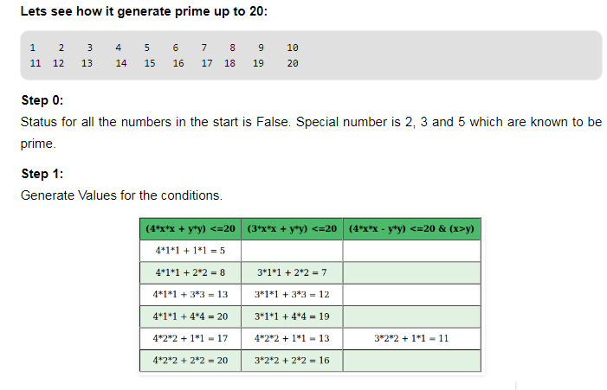

Slide 49
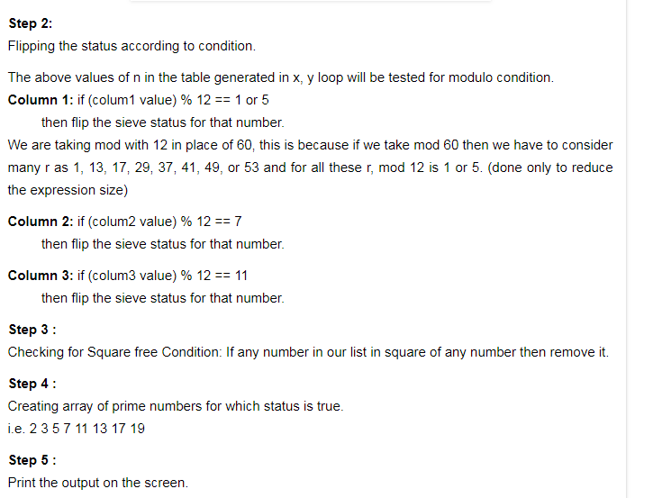

Slide 50
Problems to solve
6. Check if a number is Full Prime
7. Insert minimum number in array so that sum of array becomes prime
8. Find the prime numbers which can written as sum of most consecutive primes
9. Find two prime numbers with given sum
10. Twisted Prime Number
11. Almost Prime Numbers

Slide 51
Problems to solve
12. Check if a number can be written as a sum of ‘k’ prime numbers
13. Special prime numbers
14. Twin Prime Numbers between 1 and n
15. K-Primes (Numbers with k prime factors) in a range

Slide 52
Mansi and her series
1) Fibonacci Series: A common series in competitive coding where you need to find the N-th Fibonacci number or variations like the sum of even Fibonacci numbers. “We need to find the N-th term of a Fibonacci sequence.” if N can be large, think about optimizing your approach.
2) Arithmetic Progression (AP):
Find the N-th term of an AP: Given the first term and the common difference, calculate the N-th term.
Sum of AP series: Calculate the sum of the first N terms of an AP.
Missing term in AP: Given a sequence with one missing term, find that term.

Slide 53
3) Geometric Progression GP Series:
Find the N-th term of a GP: Given the first term and the common ratio, calculate the N-th term
Sum of GP series: Calculate the sum of the first N terms of a GP
Find common ratio: Given a sequence, find the common ratio
4) Prime Number Series: Generating prime numbers up to a limit or finding the N-th prime number.
5) Pascal Triangle

Slide 54
3) Next prime palindrome:
Brute force: Check every number starting from N to see if it is both a prime and a palindrome. k could be large as many non-palindrome, non-prime numbers are checked O(k⋅sqrt(n))
Better approach: Skip even numbers and optimize search space, but still check a large number of numbers. k' is smaller than k, but still not optimal. O(k’⋅sqrt(n))
Optimal solution: Generate palindrome numbers directly and only check palindromes for primality. k'' is much smaller as we focus only on palindrome numbers. O(k’’⋅sqrt(n))

Slide 55
import java.util.Scanner;
public class NextPrimePalindromeOptimized {
// Function to check if a number is prime
public static boolean isPrime(int num) {
if (num <= 1) return false;
if (num == 2) return true;
if (num % 2 == 0) return false;
// Check divisibility from 3 up to √num, skipping even numbers
for (int i = 3; i * i <= num; i += 2) {
if (num % i == 0) return false;
}
return true;
}
public static int nextPalindrome(int num) {
String s = Integer.toString(num);
int len = s.length();
// Handle odd and even length palindromes
String firstHalf = s.substring(0, (len + 1) / 2); // First half of the number
StringBuilder palindrome = new StringBuilder(firstHalf);
if (len % 2 != 0) {
palindrome.append(new StringBuilder(firstHalf).reverse().substring(1)); // Mirror and exclude middle
} else {
palindrome.append(new StringBuilder(firstHalf).reverse()); // Mirror completely
}
int palin = Integer.parseInt(palindrome.toString());
if (palin >= num) {
return palin;
}
// If generated palindrome is less than the number, increment and generate again
int firstHalfNum = Integer.parseInt(firstHalf) + 1;
firstHalf = Integer.toString(firstHalfNum);
palindrome = new StringBuilder(firstHalf);
if (len % 2 != 0) {
palindrome.append(new StringBuilder(firstHalf).reverse().substring(1)); // Mirror and exclude middle
} else {
palindrome.append(new StringBuilder(firstHalf).reverse()); // Mirror completely
}
return Integer.parseInt(palindrome.toString());
}
// Function to find the next prime palindrome greater than or equal to N
public static int nextPrimePalindrome(int N) {
if (N <= 2) return 2; // Handle edge case for smallest prime palindrome
int candidate = N;
while (true) {
// Generate the next palindrome
candidate = nextPalindrome(candidate);
// If it's a prime number, return it
if (isPrime(candidate)) {
return candidate;
}
// Move to the next potential palindrome
candidate++;
}
}
public static void main(String[] args) {
Scanner scanner = new Scanner(System.in);
System.out.print("Enter a number: ");
int N = scanner.nextInt();
int result = nextPrimePalindrome(N);
System.out.println("The next prime palindrome >= " + N + " is: " + result);
scanner.close();
}
}

Slide 56
You are given three numbers:
S: the target sum of the primes
P: a starting prime number
N: the number of primes to find
You need to find N prime numbers after P such that their sum equals S.
public static int[] findNPrimesAfterP(int P, int N)
{
int[] primes = new int[N];
int count = 0;
int current = P + 1; // Start checking from P+1
while (count < N)
{ if (isPrime(current))
{ primes[count] = current;
count++; }
current++;
}
return primes;
}

